Slide 1

ITS69304: Data Analytics and Machine Learning
Week 14: Cluster Analysis and Dimensionality reduction
D R . Bisan Alsalibi
S C H O O L O F C O M P U T E R S C I E N C E S TAYLOR’S UNIVERSITY

Slide 2
Outline
Formalizing unsupervised learning
Clustering
Distance measures
Clustering techniques
K-means clustering
Dimensionality Reduction

Slide 3
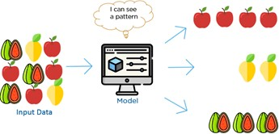
Unsupervised Learning
Have input data and no corresponding output variable (unlabeled data)
Goal: Model underlying structure or distribution in data to learn more about the data
No correct answers
Learning algorithm discovers and presents interesting structure in data
Customer Data
Age | Average Table Size | # Purchases Per Year | Amount Per Purchase (RM)
25 | 10 | 3 | 3000
40 | 20 | 2 | 5000

Slide 4
Unsupervised Learning
Dimensionality reduction: Compress the data while maintaining its structure and usefulness
Clustering: Cluster data into groups by similarity
Example: Group customers by purchasing behavior
Association rule mining: Discover rules describing large portions of the data
Example: People that buy X also tend to buy Y

Slide 5
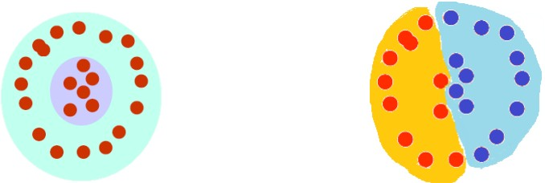
What is clustering?
Organization of unlabeled data into similarity groups called clusters
Cluster: A collection of data items which are “similar” between them, and “dissimilar” to data items in other clusters

Slide 6
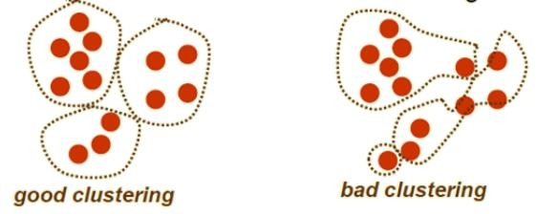
Clustering
What do we need for clustering?
Proximity measure
Similarity measure s(x_{i}, x_{k}): Large if x_{i}, x_{k} are similar
Dissimilarity (or distance) measure d(x_{i}, x_{k}): Small if x_{i}, x_{k} are similar
Criterion function to evaluate clustering
Algorithm to compute clustering
Example: Optimizing the criterion function
Notes:
Attempts to minimize distances of items within groups/clusters and maximize distances between groups/clusters
›Preprocessing
Scaling: Normalize/Standardize attributes (e.g. min-max, z-score) to avoid influence of some attributes on the distance measure (similar to the issues in k-NN classification)

Slide 7

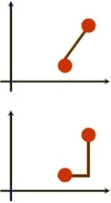

Distance (Dissimilarity) Measures
Numeric attributes
Euclidean distance
Translation invariant
Manhattan distance
Approximation to Euclidean distance
Cheaper to compute
Notes:
Invariant ثابتة

Slide 8
Cluster Evaluation
Intra-cluster cohesion (compactness)
Cohesion measures how near the data points in a cluster are to the cluster centroid
Sum of squared error (SSE) is a commonly used measure
Inter-cluster cohesion (isolation)
Separation means that different cluster centroids should be far away from one another
Expert judgments are still the key in most applications

Slide 9
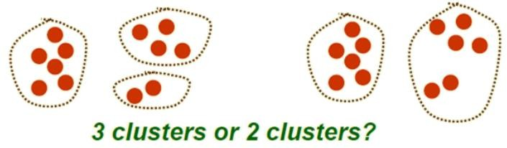
How many clusters?
Possible approaches
Fix the number of clusters to k
Find the best clustering according to criterion function (number of clusters may vary)

Slide 10
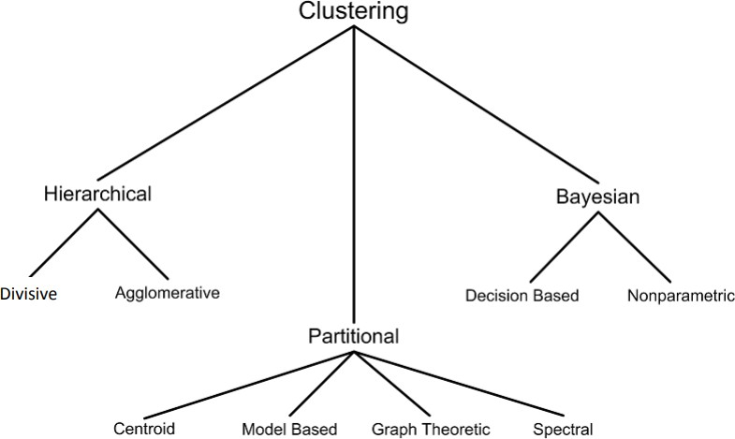
Clustering Techniques

Slide 11
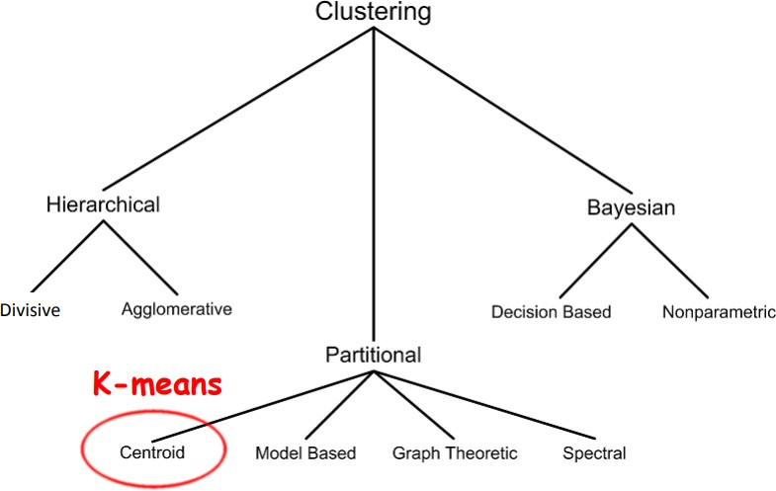
Clustering Techniques

Slide 12
K-Means Clustering
Partitional, Center-based clustering algorithm
The k-means algorithm partitions the given data into k
clusters
Each cluster has a cluster center, called centroid
Value of k is specified by the user
Notes:
Partitional= no hierarchies, data point belongs to exactly one cluster
›Center-based= data points closest to “center” of cluster
K-means uses the Euclidean distance as a distance metric
›Hence, appropriate only for numerical vectors
›Note: Variations of K-means for vectors with qualitative attributes available e.g. K-modes
The “K” in “K-means” is the number of desired clusters

Slide 13
Cluster Centroid
Centroid
“Middle” of a cluster
Pseudo instance of data where each attribute is the “mean” of all attribute values in the cluster
Compute mean for numerical variables
Example: (A₁₁, A₁₂), (A₂₁, A₂₂), (A₃₁, A₃₂) belongs to the same cluster
Centroid: ((A₁₁ + A₂₁ + A₃₁)/3, (A₁₂ + A₂₂ + A₃₂)/3)
Use majority rules for binary or nominal variables

Slide 14
K-Means Algorithm
Given k
Choose k (random) data points (seeds) to be the initial
centroids, cluster centers
Assign each data point to the closest centroid
Re-compute the centroids using the current cluster memberships
If a convergence criterion is not met, repeat steps 2 and 3

Slide 15

K-Means Convergence Criterion
When to stop?
No or minimum re-assignments of data points to different clusters
OR
No or minimum change of centroids
OR
Minimum decrease in the sum of squared error (SSE)
C_{j} is the j^{th} cluster
m_{j} is the centroid of cluster C_{j} (the mean vector of all the data points in C_{j})
d(x, m_{j}) is the (Euclidean) distance between data point x and centroid m_{j}

Slide 16
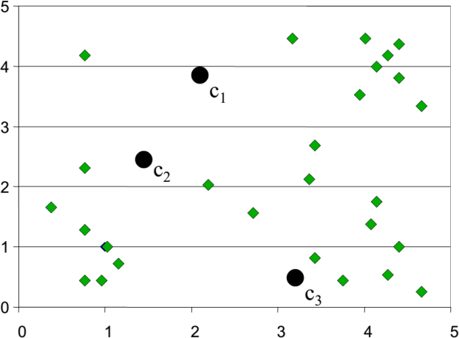
K-Means Clustering: Example
Step 1: Randomly initialize the cluster centers (initial centroids)

Slide 17
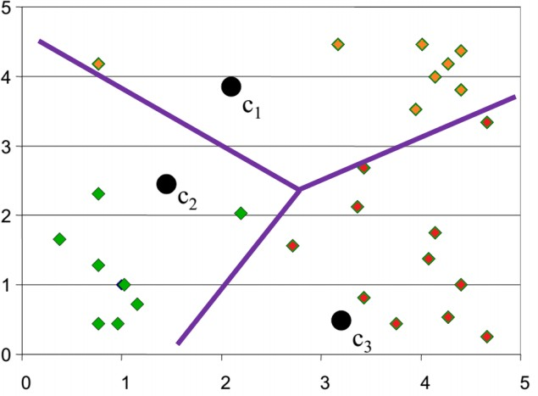
K-Means Clustering: Example
Step 2: Determine cluster membership for each input data point
Compute the (Euclidean) distance between each data point to each centroid
Each data point is assigned to the nearest centroid’s cluster

Slide 18
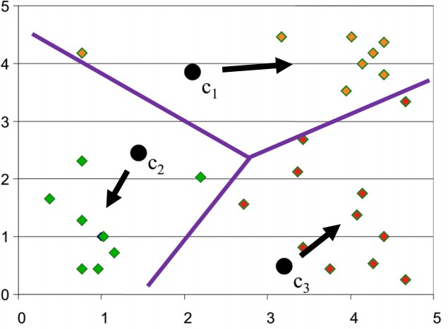
K-Means Clustering: Example
Step 3: Re-estimate cluster centers (centroids)
Move the centroids to the center of their clusters

Slide 19
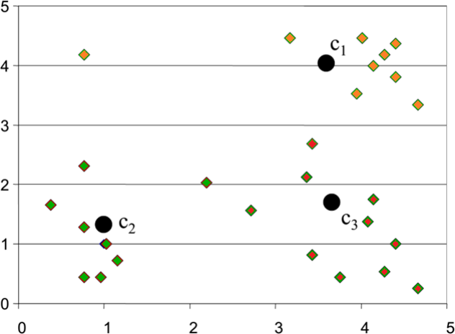
K-Means Clustering: Example
Result of the FIRST
iteration

Slide 20
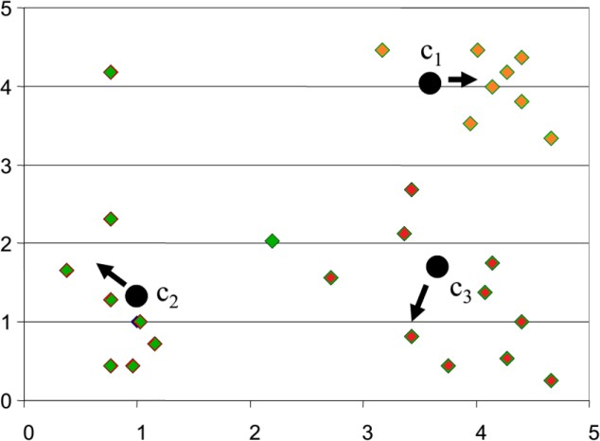
K-Means Clustering: Example
SECOND iteration

Slide 21
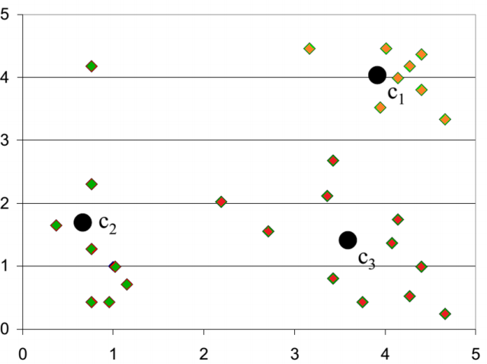
K-Means Clustering: Example
Result of the SECOND
iteration

Slide 22



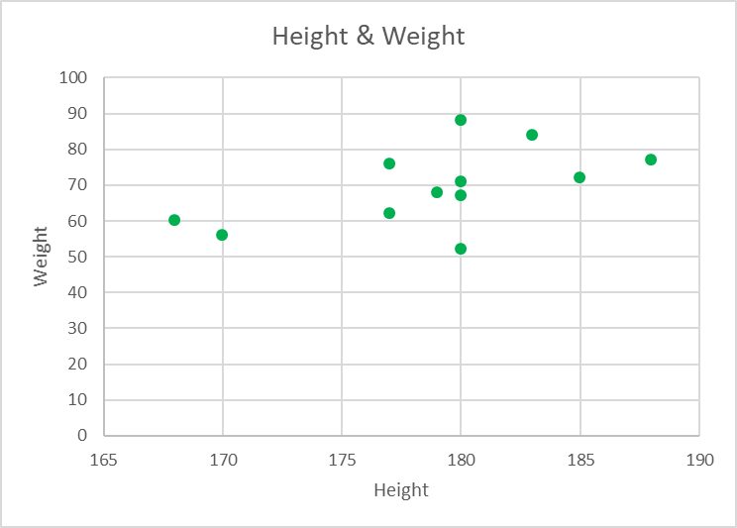
Assume K=2, i.e. cluster data set of
people into 2 (K=2) clusters
› K always given as input
Step 1: select 2 initial centroids.
› Various ways to do it
Select 2 (=K) points of the data space randomly
Height=190, Weight=102 and Height=169, Weight=59 (note: not in dataset)
Select 2 (=K) arbitrary points from the dataset
select first two observation as centroids,
Height=185, Weight=72 and Height=170, Weight=56
We use this!
Data set (Height, Weight)
Centroids
 | Height | Width
Cluster 1 | 185 | 72
Cluster 2 | 170 | 56
Height | Weight
185 | 72
170 | 56
168 | 60
179 | 68
182 | 72

Slide 23



Example: K-means, K=2
Height | Weight
185 | 72
170 | 56
168 | 60
179 | 68
182 | 72
Centroids
 | Height | Width | Data in cluster
Cluster 1 | 185 | 72 | (185, 72) ,(179,68), (182,72)
Cluster 2 | 170 | 56 | (170,56), (168,60)
Step 2: Calculate distance of all other data points from the 2 centroids and add data to closest cluster
› Use Euclidean distance
Data set (Height, Weight)
168,60: distance from cluster 1 = sqrt( (185-168)^2 + (72-60)^2) = 20.82
168,60: distance from cluster 2 = sqrt( (170-168)^2 + (56-60)^2) = 4.47 (PUT in this cluster) 179, 68: distance from cluster 1 = sqrt( (185-179)^2 + (72-68)^2) = 7.21 (Put in this cluster) 179, 68: distance from cluster 2 = sqrt( (170-179)^2 + (56-68)^2) = 15
182,72: distance from cluster 1 = sqrt( (185-182)^2 + (72-72)^2) = 3 (PUT in this cluster) 182,72: distance from cluster 2 = sqrt( (170-182)^2 + (56-72)^2) = 20

Slide 24



Example: K-means, K=2
Height | Weight
185 | 72
170 | 56
168 | 60
179 | 68
182 | 72
Centroids
 | Height | Width | Data in cluster
Cluster 1 | 185 | 72 | (185, 72), (179,68), (182,72)
Cluster 2 | 170 | 56 | (170,56), (168,60)
Step 3: Calculate new centroids from data in cluster
Data set (Height, Weight)
Cluster 1: Height : (185+179+182)/3 = 182, Weight: (72+68+72)/3 = 70.6 Cluster 2: Height: (170+168)/2 = 169, Weight: (56+60)/2 = 58
NEW Centroids
 | Height | Width
Cluster 1 | 182 | 70.6
Cluster 2 | 169 | 58

Slide 25



Example: K-means, K=2
Height | Weight
185 | 72
170 | 56
168 | 60
179 | 68
182 | 72
NEW Centroids
 | Height | Width
Cluster 1 | 182 | 70.6
Cluster 2 | 169 | 58
Step 4: Have centroids moved (or has data moved clusters)? Yes. Hence continue iteration
Data set (Height, Weight)

Slide 26



Example: K-means, K=2
Height | Weight
185 | 72
170 | 56
168 | 60
179 | 68
182 | 72
Centroids
 | Height | Width | Data in cluster
Cluster 1 | 182 | 70.6 | (185,72), (179,68), (182,72)
Cluster 2 | 169 | 58 | (170,56), (168,60)
Step 5: : Calculate distance of all other data points from the 2 new centroids and add data to closest cluster
Data set (Height, Weight)
185,72: distance from cluster 1 = sqrt( (182-185)^2 + (70.6-72)^2) = 3.31 (PUT in this cluster) 185,72: distance from cluster 2 = sqrt( (169-185)^2 + (58-72)^2) = 21.26
170, 56: distance from cluster 1 = sqrt( (182-170)^2 + (70.6-56)^2) = 18.89
170, 56: distance from cluster 2 = sqrt( (169-170)^2 + (58-56)^2) = 2.23 (PUT in this cluster) 168,60: distance from cluster 1 = sqrt( (182-168)^2 + (70.6-60)^2) = 17.56
168,60: distance from cluster 2 = sqrt( (169-168)^2 + (58-60)^2) = 2.23 (PUT in this cluster) 179,68: distance from cluster 1 = sqrt( (182-179)^2 + (70.6-68)^2) = 3.96 (PUT in this cluster) 179,68: distance from cluster 2 = sqrt( (169-179)^2 + (58-68)^2) = 14.14
182,72: distance from cluster 1 = sqrt( (182-182)^2 + (70.6-72)^2) = 1.4 (PUT in this cluster) 182,72: distance from cluster 2 = sqrt( (169-182)^2 + (58.6-72)^2) = 18.66

Slide 27

Example: K-means, K=2
Height | Weight
185 | 72
170 | 56
168 | 60
179 | 68
182 | 72
Centroids
 | Height | Width | Data in cluster
Cluster 1 | 182 | 70.6 | (185,72), (179,68), (182,72)
Cluster 2 | 169 | 58 | (170,56), (168,60)
Step 6: Calculate new centroids from data in cluster
Data set (Height, Weight)
Cluster 1: Height : (185+179+182)/3 = 182, Weight: (72+68+72)/3 = 70.6 Cluster 2: Height: (170+168)/2 = 169, Weight: (56+60)/2 = 58
NEW Centroids
 | Height | Width
Cluster 1 | 182 | 70.6
Cluster 2 | 169 | 58

Slide 28

Example: K-means, K=2
Height | Weight
185 | 72
170 | 56
168 | 60
179 | 68
182 | 72
NEW Centroids
 | Height | Width
Cluster 1 | 182 | 70.6
Cluster 2 | 169 | 58
Step 7: Have centroids moved (or has data moved clusters)? NO. Sweet! K-means terminates
Data set (Height, Weight)
The final two clusters of our data set are:
Cluster 1: (185,72), (179,68), (182,72)
Cluster 2: (170,56), (168,60)

Slide 29

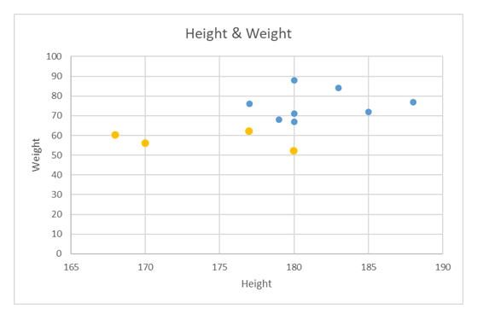

Slide 30




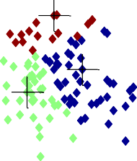
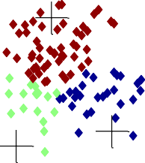
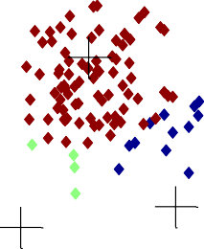



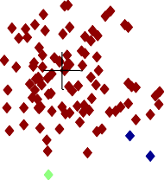
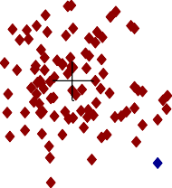




Centroids
Iteration 1
Iteration 2
Iteration 3
3
3
3
2.5
2.5
2.5
2
2
2
1.5
1.5
1.5
y
1
y
1
y
1
0.5
0.5
0.5
0
0
0
-2
-1.5
-1
-0.5
0
x
0.5
1
1.5
2
-2
-1.5
-1
-0.5
0
x
0.5
1
1.5
2
-2
-1.5
-1
-0.5
0
x
0.5
1
1.5
2
Iteration 4 Iteration 5
3 3 3
Iteration 6
2.5
2.5
2.5
2
2
2
1.5
1.5
1.5
y
1
y
1
y
1
0.5
0.5
0.5
0
0
0
-2 -1.5 -1
-0.5 0
x
0.5 1 1.5 2
-2 -1.5 -1
-0.5 0
x
0.5 1 1.5 2
-2 -1.5 -1
-0.5 0
x
0.5 1 1.5 2
Note how centroids shift/move at each iteration as a result of step 4 of algorithm i.e. recomputing the centroid of each cluster by calculating the mean of points of cluster.

Slide 31
Strengths
Simple: Easy to understand and implement
Efficient in terms of time complexity
Considered a linear algorithm since both number of clusters and number of iterations are small
The most popular clustering algorithm

Slide 32
Weaknesses
Only applicable if the mean is defined
For categorical data, k-mode - centroid is represented by the most frequent values
User needs to specify k
Sensitive to outliers
Outliers are data points that are very far away from other data points
Outliers could be errors in the data recording or some special data points with very different values

Slide 33
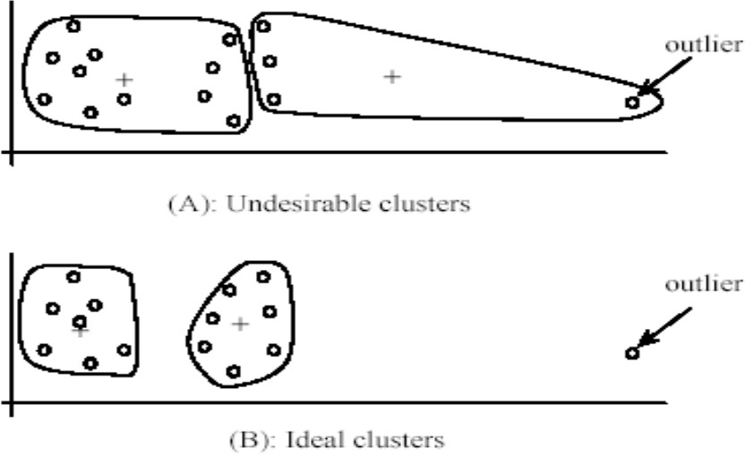
Weaknesses
Dealing with
outliers
Remove some data points that are much further away from the centroids than other data points
outlier
(A): Undesirable clusters
outlier
(B): Ideal clusters

Slide 34
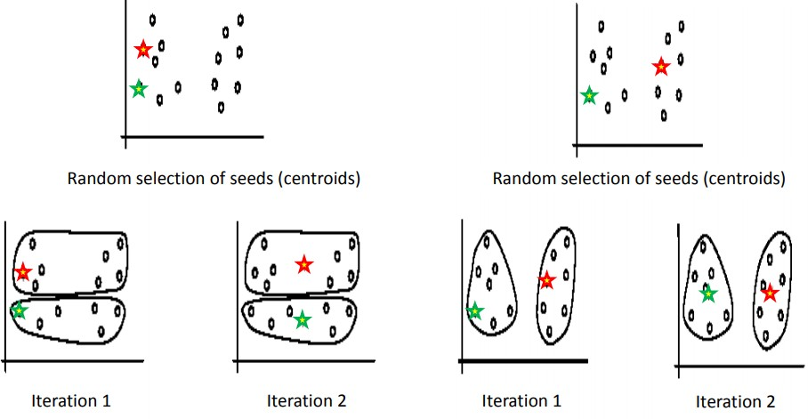
Weaknesses
Sensitivity to initial seeds (initial centroids)
Terminates at a local optimum if SSE is used
Global optimum is hard to find due to complexity

Slide 35
Summary
K-means is still the most popular clustering algorithm due to its simplicity and efficiency
Comparing different clustering algorithms is a difficult task
Why?
No one knows the correct clusters!

